Slide 1
Perfect Competition: Part 2
Steven Suranovic
George Washington University

Slide 2
Deriving the Market Supply Curve
A supply curve is a relationship between the market price and the quantity supplied to the market by all the firms
It is hypothetical because it identifies the quantity supplied at all possible prices that might occur.
The actual price occurs at the equilibrium where the quantity supplied equals the quantity demanded (more about this later)

Slide 3
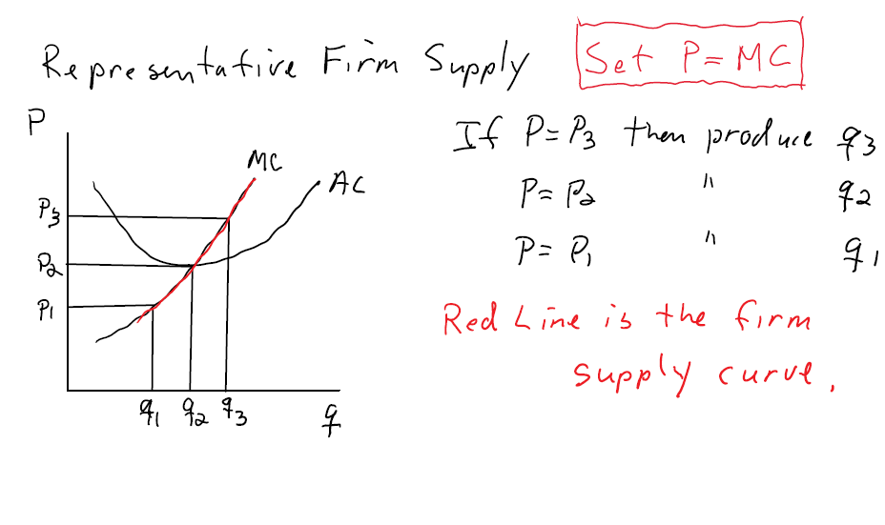
Deriving a Single Firm Supply Function
A PC firm chooses quantity q such that P = MC
Note that the quantity supplied is determined by the position of the firm’s MC curve

Slide 4
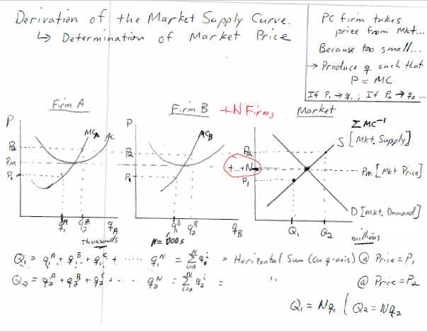

Slide 5
Why is the Supply Curve Positively-Sloped
A supply curve displays a positive relationship between price and quantity → as the price rises, market supply rises
Equivalently, firms require a higher market price to induce them to supply more

Slide 6
Why is the Supply Curve Positively-Sloped
Supply curve is positively-sloped because the MC curve is positively-sloped.
But why is that?
MC curve is positively-sloped because of the presence of decreasing returns to scale (falling marginal product → DRS)
IRS generates declining MC
CRS and no fixed costs generate fixed, or constant, MC
DRS means that producing more costs more in terms of labor input and therefore firms will require a higher price to pay the higher costs

Slide 7
When should PC firms stop producing
Intuition would suggest that if a firm is losing money, that is, if profit is negative, then it should stop producing …. But this turns out to be wrong
Firms that have fixed costs will not automatically shut down because it is not always the profit-maximizing decision

Slide 10
When should PC firms stop producing
The reason firms may stay in business even when losing money is because the cost of going out of business may be higher (due to the need to pay the fixed costs even with zero output)
However, eventually fixed costs can disappear, for example the lease on company rental space expires
This implies that eventually firms losing money will go out of business.

Slide 11
Long-run Adjustment in a PC Market
In a PC model the long-run represents the period of time needed for entry of new firms or exit of incumbent firms to take place
This process may take months or years to conclude
Entry of new firms is inspired by positive profits
Exit of incumbent firms is inspired by losses

Slide 12
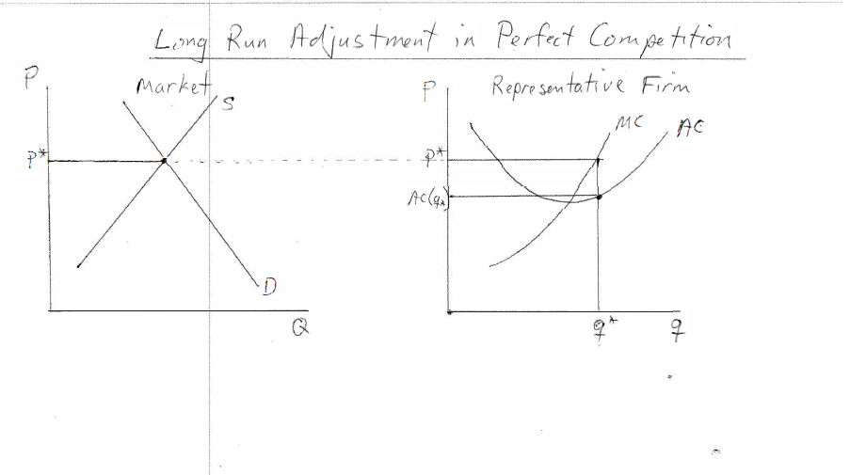

Slide 13
Long-run Adjustment in a PC Market
Positive profit by rep. firms in the market signals other firms to enter the business
Note we assume perfect information which means everyone outside the industry knows that profit is being made
Entry of one firm has no effect on market but entry of many firms raises total market supply and lowers the equilibrium price
The lower price causes a reduction in rep. firm profit
Process continues until profit = 0

Slide 14
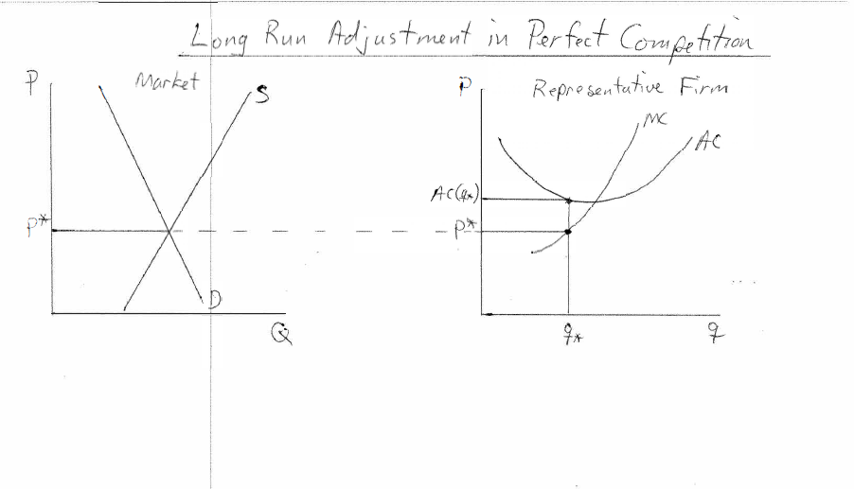

Slide 15
Long-run Adjustment in a PC Market
Negative profit by rep. firms in the market leads to firms exiting business as time progress (this happens gradually as fixed costs disappear)
Exit of one firm has no effect on market but exit of many firms lowers total market supply and raises the equilibrium price
The higher price causes an increase in rep. firm profit
Process continues until profit = 0

Slide 16
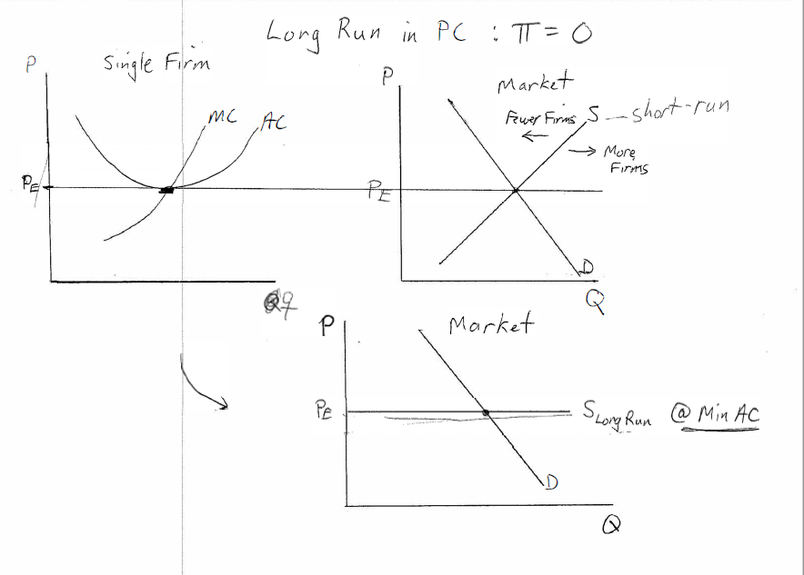
Long-run Supply Curve in a PC Market

Slide 17
Long-run Supply Curve in a PC Market
The long-run supply curve is horizontal at the price that minimizes average cost of production
This means that if PC firms max profit and have perfect information then the “invisible hand” will result in production of goods occurring at a scale that lowers the unit-costs (AC) to a minimum
→ most efficient resource usage (minimize waste) occurs in a LR PC equilibrium

Slide 18
Consider the cost curves for a representative firm in the perfectly competitive vanilla bean industry. ATC is the average total cost, AVC is the average variable cost and MC is the firm's marginal cost.

Slide 19
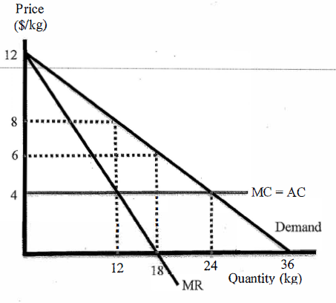
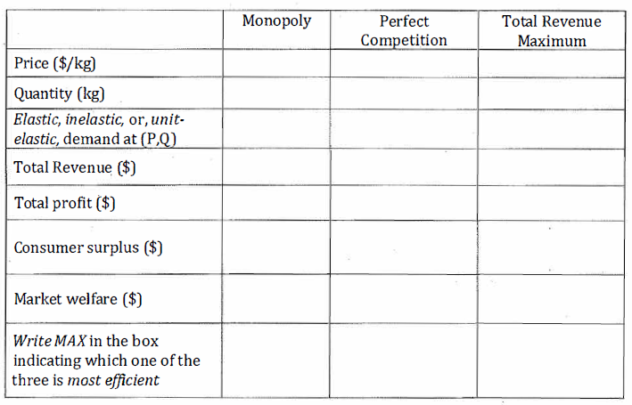
Consider the market for cotton depicted in the following diagram with a downward sloping market demand cu rve. Suppose there are constant returns to scale and no fixed costs in production which generates a marginal and average total cost of $4 as drawn. Fill in the table below for the profit maximizing outcome in each of the market situations. [NOTE: the total revenue maximum occurs where MR = O.]

